Slide 1
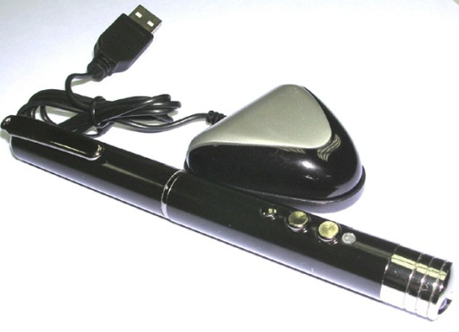
5 pen pc technology
Submitted By:
Aleesha Kurian
S1 MCA

Slide 2
contents
Introduction
History
Working Principle
Functions
Block Diagram
How it takes input?
Why it works with windows only?
Connectivity 802.11B/G and Blue tooth
Advantages and disadvantages
Applications
Conclusion
References

Slide 3
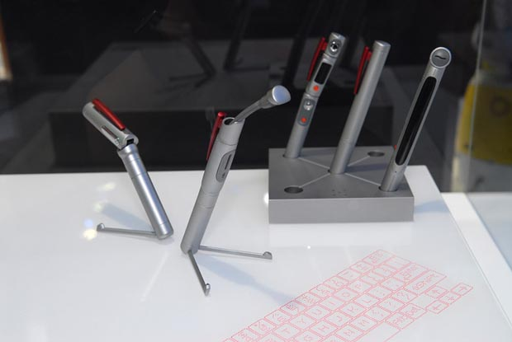
INTRODUCTION
P-ISM (“Pen-style Personal Networking Gadget Package”).
Connected with a wireless technology.
Whole set is connected to internet through cellular phone function.
This 'pen sort of instrument' produces both the monitor as well as the keyboard on any flat surfaces from where you can carry out functions you would normally do on your desktop computer.

Slide 4
HISTORY
P-ISM was first featured at the 2011 ITU Telecom world held in Geneva, Switzerland.
Pen-style personal networking gadget created in 2012 by japanese technology company NEC.
Its designer Tour Ichihash.

Slide 5
How does it work?
5 pens have unique functions.
P-ISM’s are connected with Bluetooth .
whole set is connected to the Internet through the cellular phone function.

Slide 6
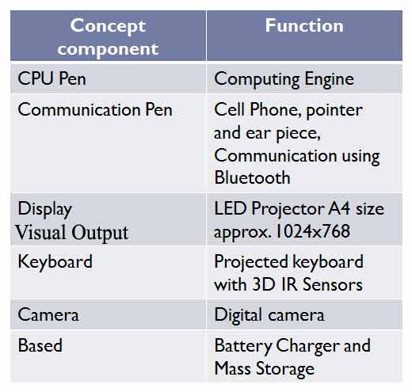
P-ISM includes 5 functions

Slide 7
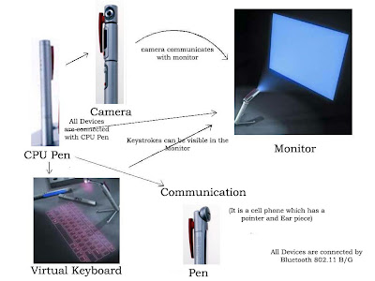
Block diagram of P- ISM

Slide 8
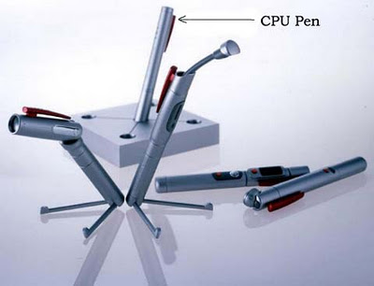
CPU Pen
The functionality of the CPU is done by
one of the pen.
known as computing engine.
Dual Core processor
is used.
Works with windows operating system.

Slide 9

Communication Pen
Wireless Bluetooth Technology.
Connected to internet
through cellular phone
function.
Uses Wi-Fi technology.
Exchange information
with wireless connection.

Slide 10
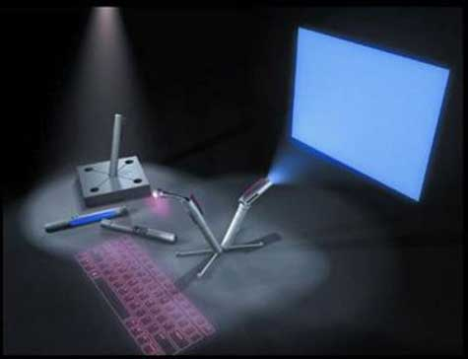
LED Projector
Monitor is LED Projector.
Size of an A4 paper.
Resolution capacity is1024x768px approx.
It gives more clarity and good picture.

Slide 11
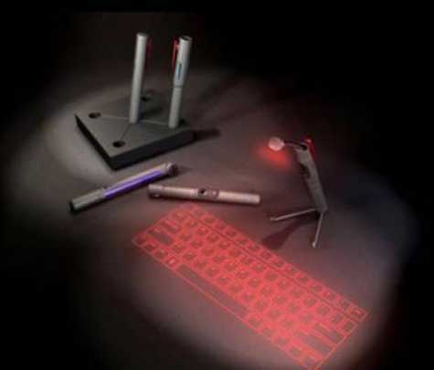
Virtual Keyboard
Virtual laser keyboard is a new gadget.
It emits laser on desk.
Uses laser beam to generate full-size perfect keyboard.
VKB settings can be changed.

Slide 12

Digital Camera
It is useful in video recording , video conferencing simply as a webcam.
Connected with other devices.
portable.
360 degree visual communication device.

Slide 13
Battery
It is the most important part in the portable type of computers.
Usually batteries are small in size and work for a long time.
It comes with a battery life of 6+ (i.e. 6 days).
For normal use it can be used for 2 weeks.
How it takes input
It has two methods for input
With the virtual keyboard.
With digital camera.

Slide 14
Merits
Portable
Feasible
Ubiquitous computing is done
Wi-Fi technology
Pens produces both the monitor as well as the keyboard on any flat surfaces from where you can carry out functions.

Slide 15
Demerits
Cost
Battery
Keyboard concept is not new
Positioning is main

Slide 16
Why it works with windows only?
It consists of dual core processor embedded in it and that is why it works only with WINDOWS operation system.
APPLICATIONS
Many researches has been made but there is no clear result so far.
Only one that uses it is E-fingerprinting the gadget will be more secure, which allows only owner to activate the Pc. So even if we loose it, no one else can access the gadget.

Slide 17
CONCLUSION
The communication devices are becoming smaller and compact.
5 Pen PC is only an example for the start of this new technology.
We can expect more such developments in the future.

Slide 18
REFERENCES
www.studimafia.com
www.scribd.com

Slide 19
THANK YOU

